Slide 1



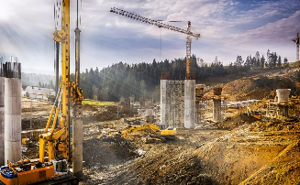
Concrete Strength Prediction
REGRESSION PROJECT
GROUP MEMBERS:
K.MANIKANTA
D.BHARATH
ARYAN VAKHARIA
A.VASUDEV
A.AAKASH
AURORA’S DEGREE AND P.G. COLLEGE
(B.SC. COMPUTER SCIENCE & DATA SCIENCE)​
1

Slide 2
INDEX
Content | Slide Numbers
Imported Libraries | 3
Techinical Approximations | 4
Project Background | 5
Data Quality Matters | 6
EDA (Pairplots,Heatmap,Distribution Plot,Box plots,Scatter plots) | 7
Machine learning Algorithms compression test | 16
Appendix | 21
Conclusion | 26

Slide 3
IMPORTED LIBRARIES
MACHINE LEARNING
LIBRARIES
LIBRARIES
Pandas​
Linear Regression
Matplotlib​
Random Forest
Seaborn​
Ridge Regression
Numpy
Lasso Regression

Slide 4
About the data:
The pridiction of compressive strength of concrete is the project all about
Objective:
Objective of our project is to investigate , check the data and analyse the data given of the errors which effect the compressive strength of concrete
The path:
For the data given we test and by using machine learning models to get the best of all from the dataset

Slide 5
Data and Data Cleaning
Data introduction:
The data consists of 9 colomns and 1030 observation
Attributes:
CONCRETE COMPRESSIVE STRENGHT | DEPENDENT VARIABLES,CONCRETE STRENGTH
Cement | Cement quantify measured in kg/m3.
Blast furnace | Blast furnace slag usage in kg/m^3.
Fly ash | The fly ash usage, in kg/m^3 as SCM.
Water | The water-to-cement ratio, is measured in kg/m^3.
Super plasticizer | The amount of superplasticizer needed for concrete workability is measured in kg/m^3
Coarse aggregate | Coarse aggregate quantity in kg/m^3
Fine aggregate | The fine aggregate used in the mix is measured in kg/m^3
Age | Concrete age at strength measurment
5

Slide 6
Exploratory Data Analysis (EDA):
In EDA we find Heat map , Distribution plot , Box plot , Scatter plots , Pair plots and at last we have Concrete Compressive Strength prediction regression output using cements data

Slide 7
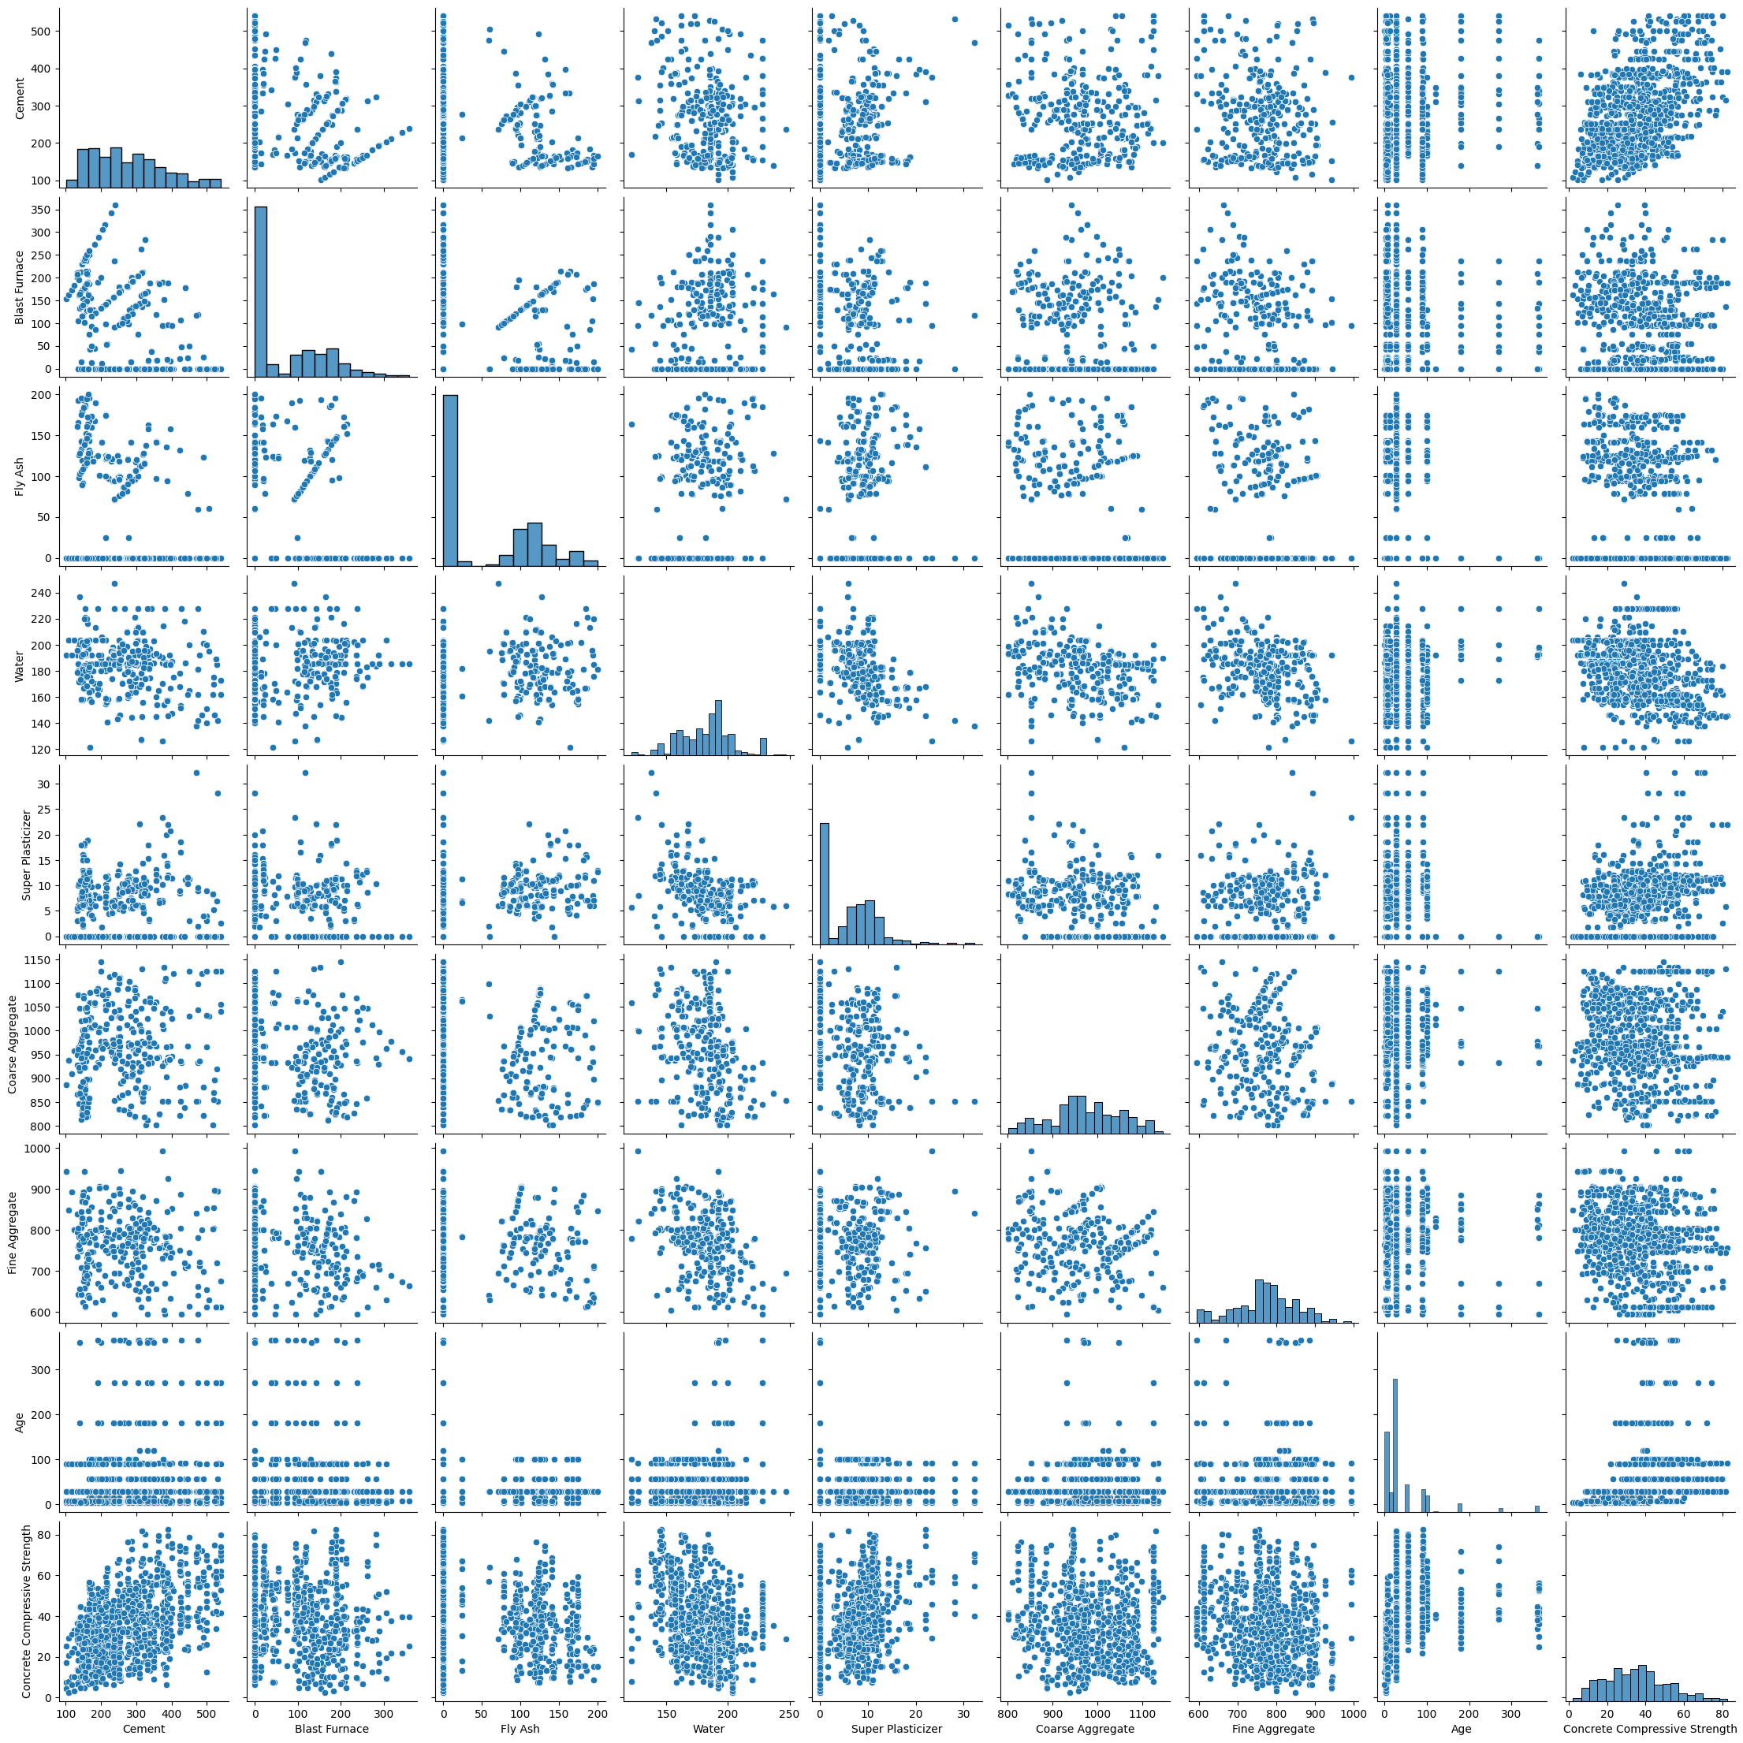
PAIR PLOT:
A pair plot is a data visualization that plots pair-wise relationships between all the variables of a dataset

Slide 8
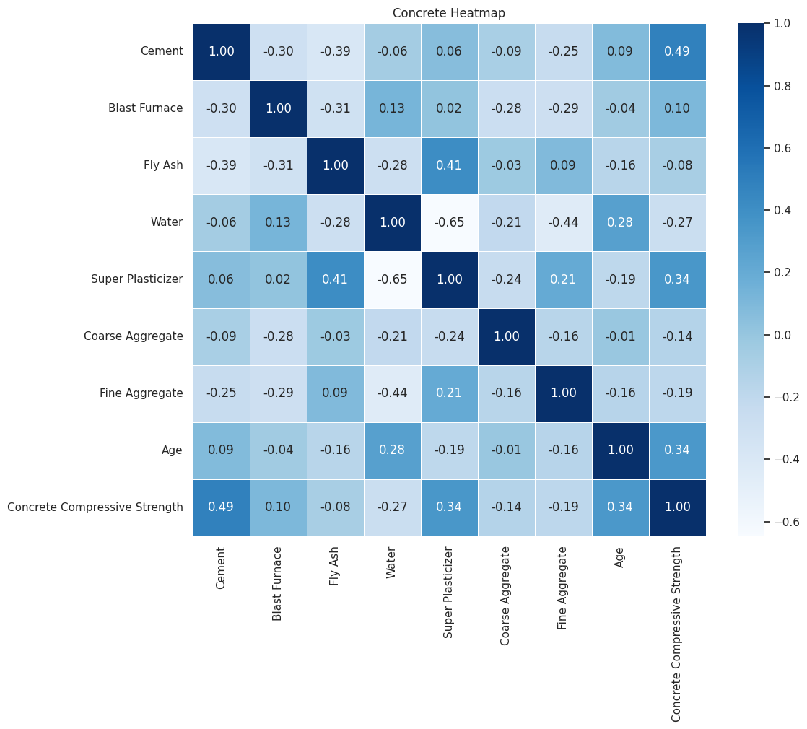
HeatMap:
Key Insights
Cement is highly positively correlated with the target variable (Concrete Compressive Strength).
Water is highly negatively correlated with the target variable (Concrete Compressive Strength).
Water has a strong correlation with Super Plasticizer.

Slide 9
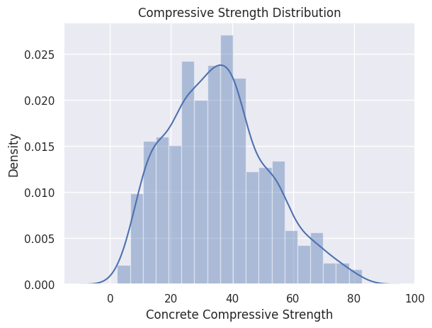
Distribution Plot

Slide 10
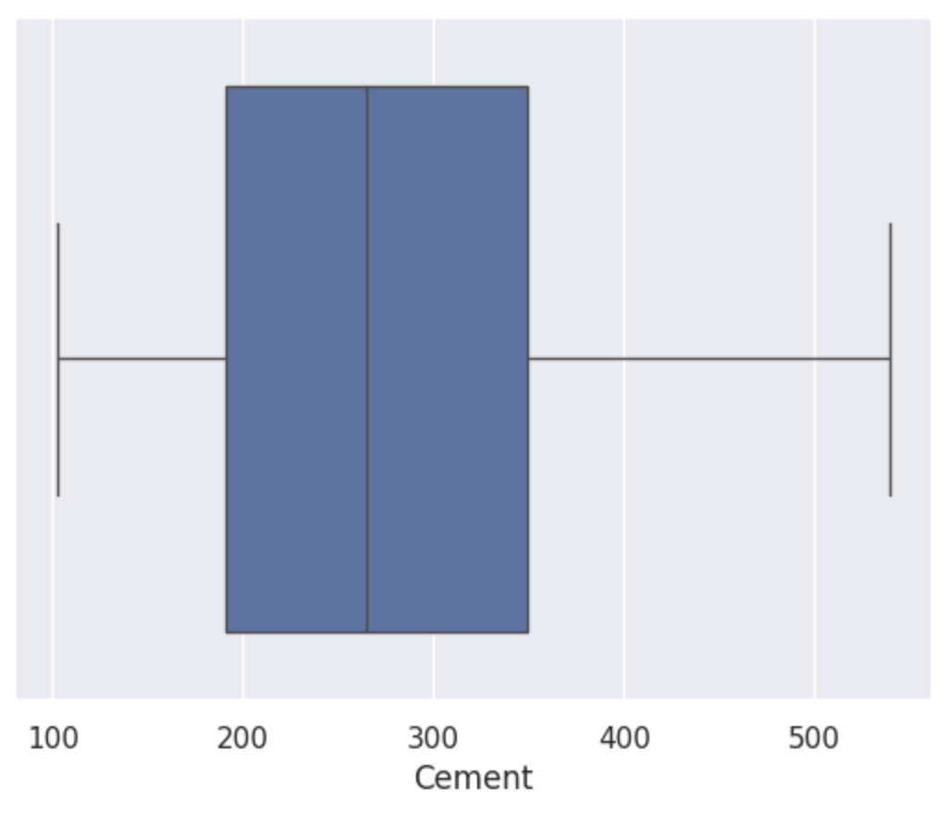
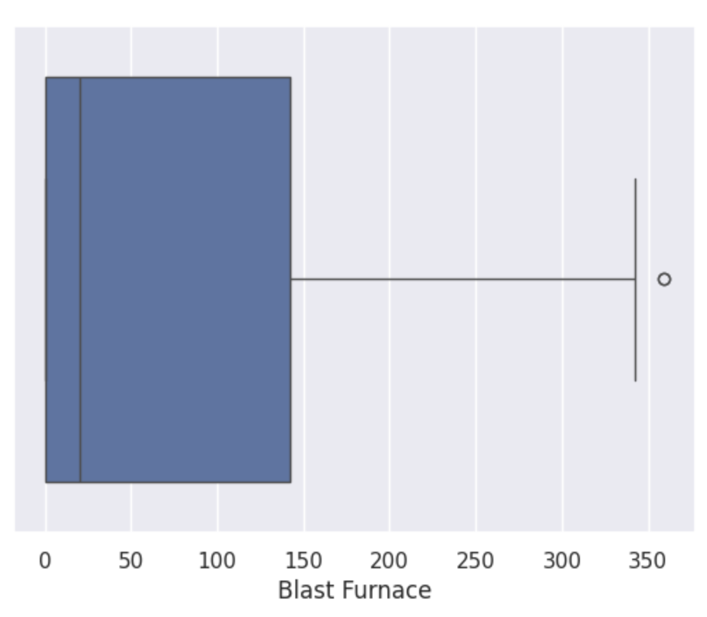
BOX PLOT
CEMENT
BLAST FURNACE

Slide 11
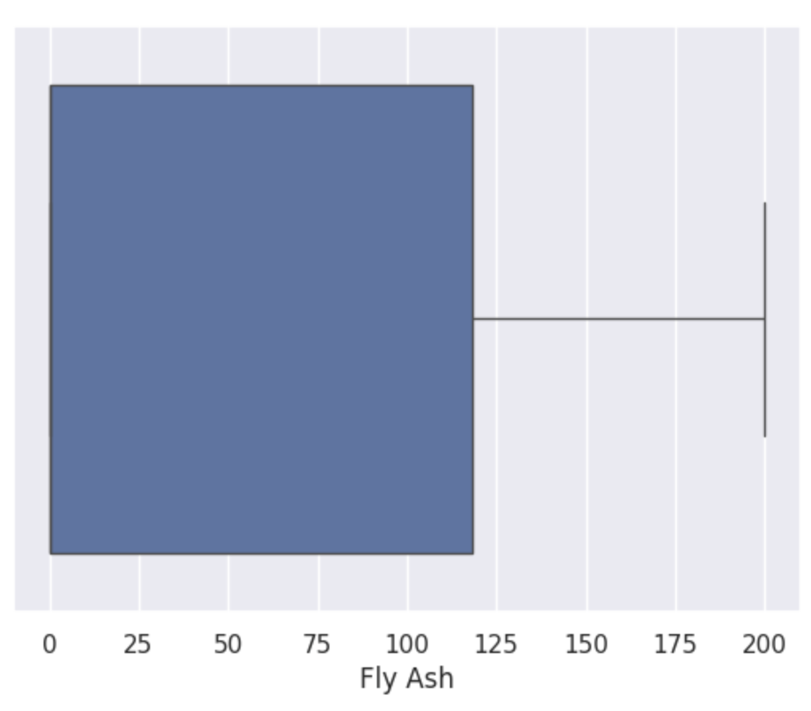
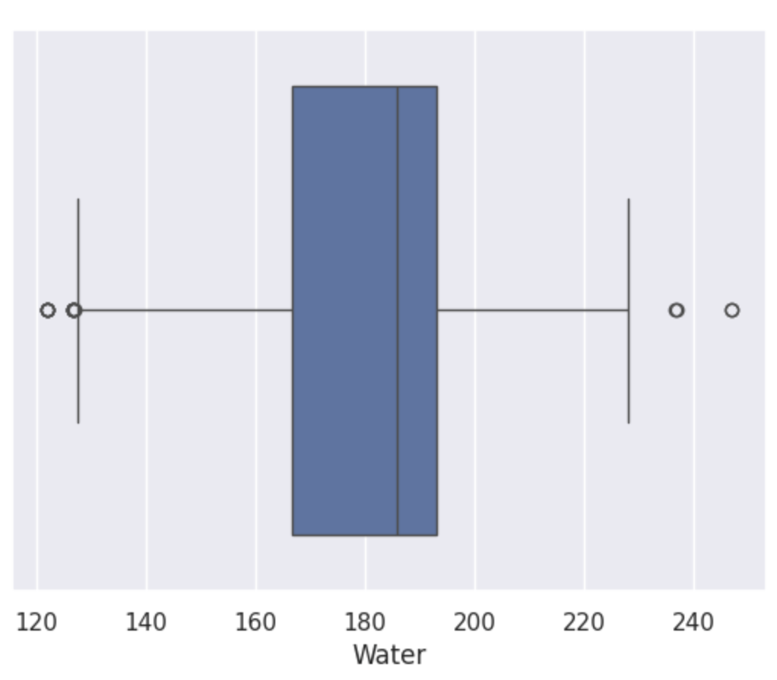
FLY ASH
WATER

Slide 12
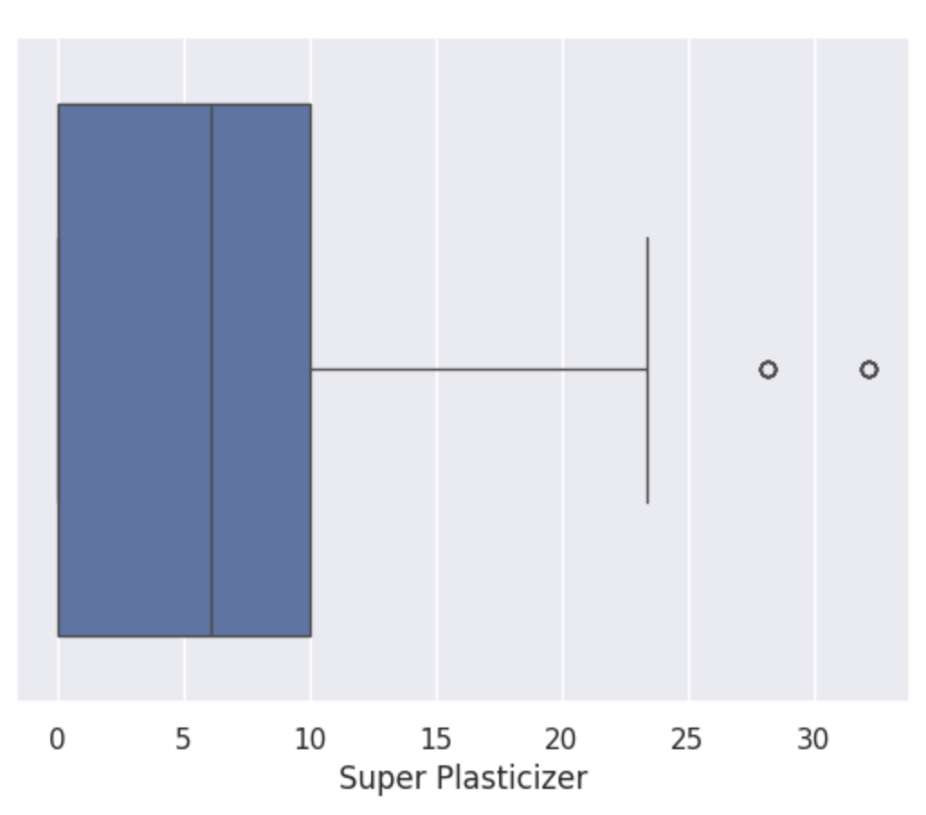
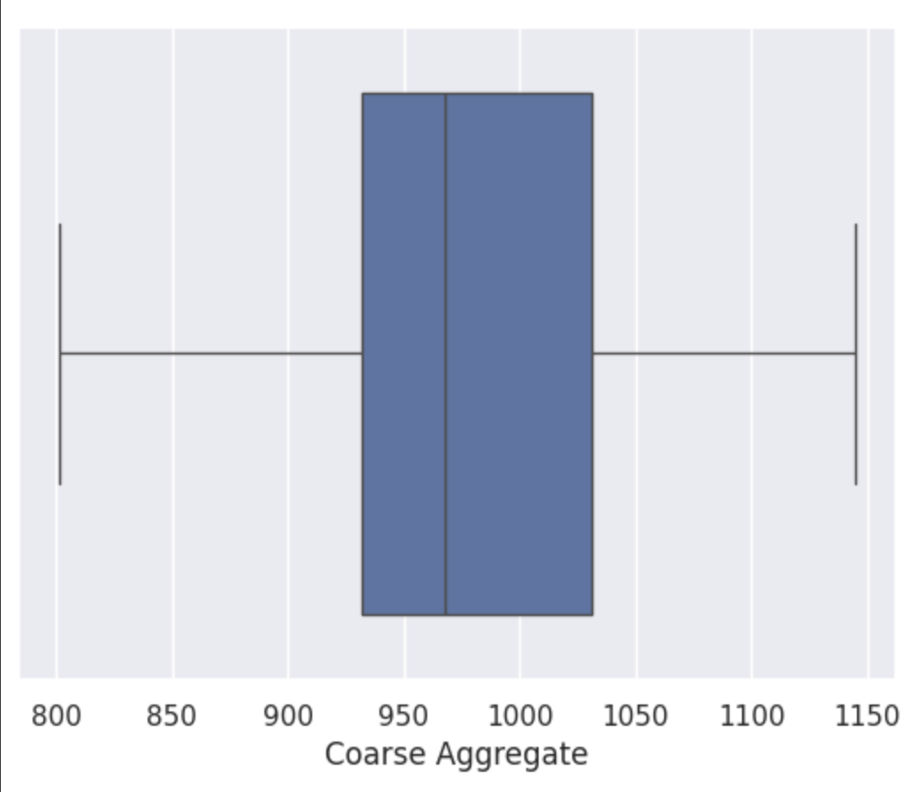
SUPER PLASTICIZER
COARSE AGGREGATE

Slide 13
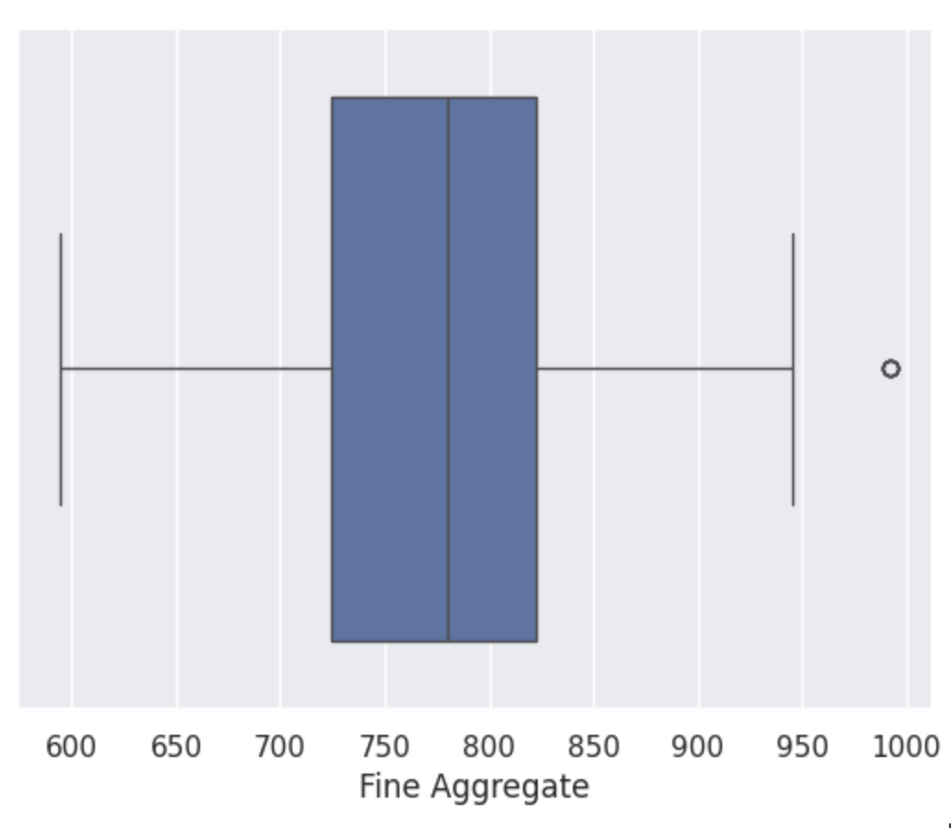
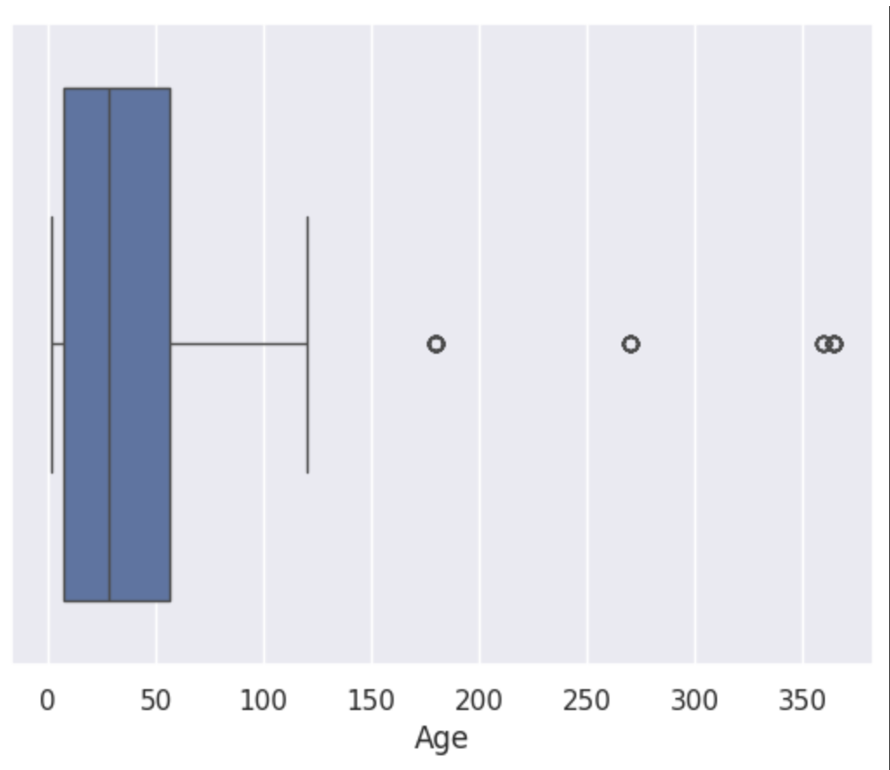
FINE AGGREGATE
AGE

Slide 14
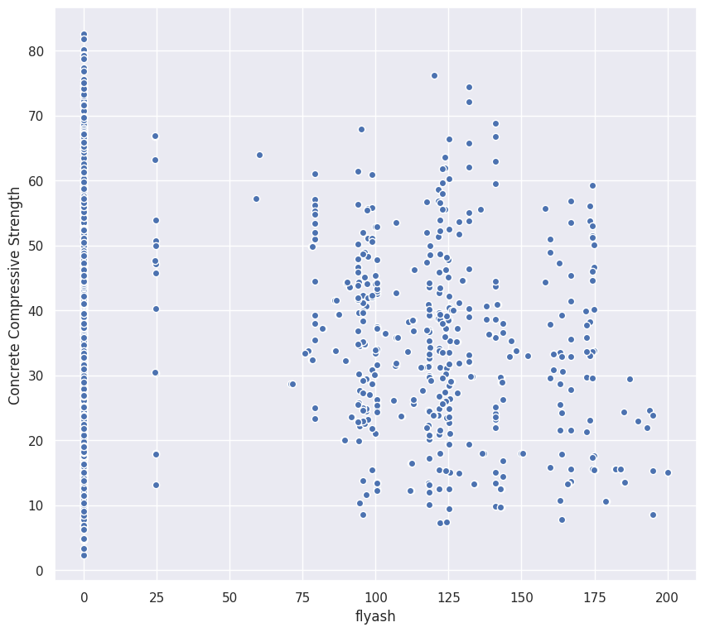
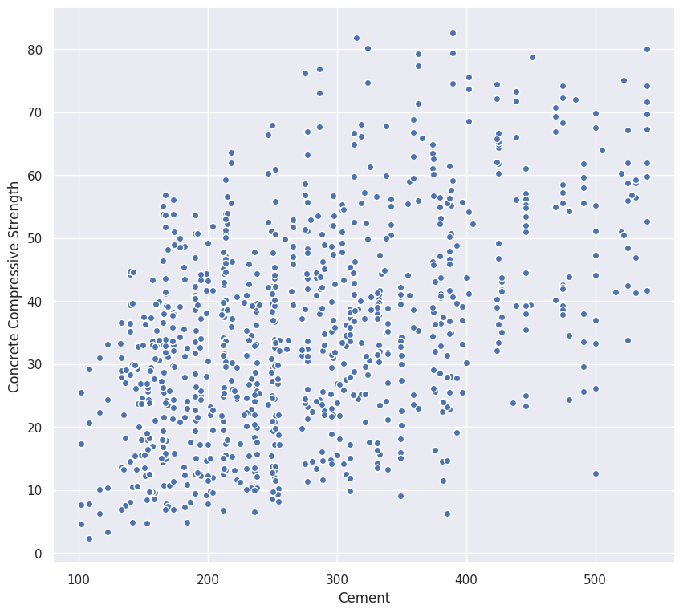
SCATTER PLOT
SCATTER PLOT OF FLYASH
SCATTER PLOT OF CEMENT

Slide 15
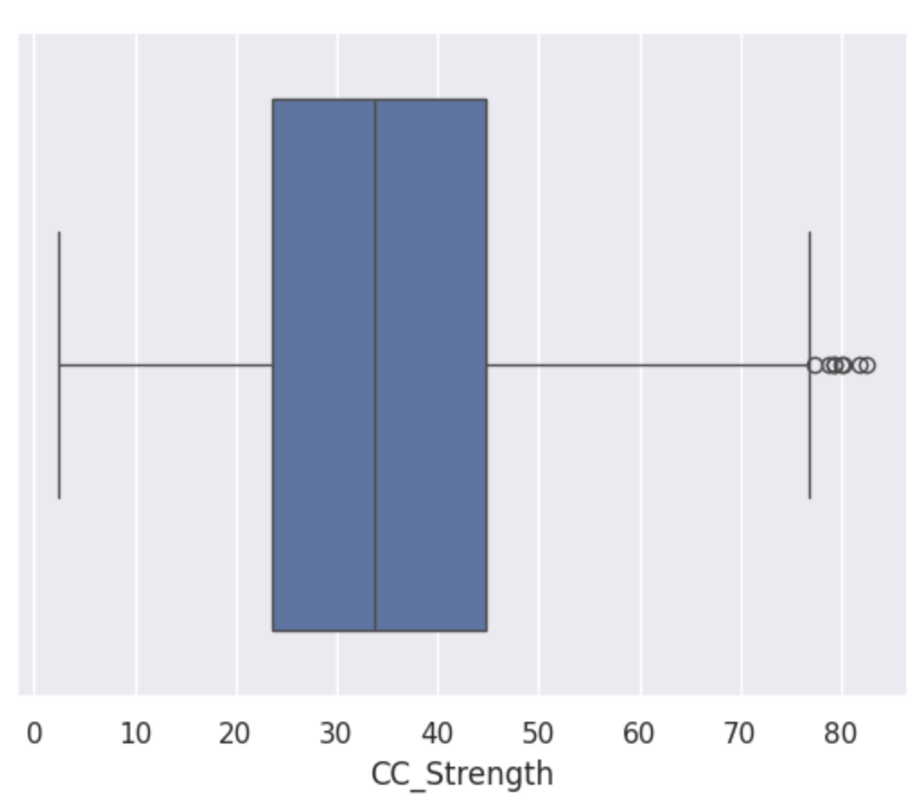
CC_STRENGTH
Box plot
It is a simple way to visualize the shape of our data. It makes comparing characteristics of data between categories very easy.

Slide 16
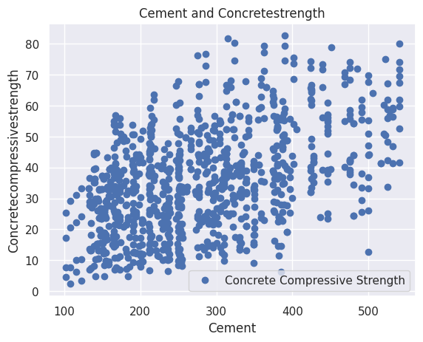
CONCRETE COMPRESSIVE STRENGTH GIVING OUT THE LINEAER REGRESSION USING CEMENT DATA

Slide 17
Linear Regression
TRAIN TEST RATIO | PS | MSE | MAE | COD | RMSE
80-20 | 0.5842 | 106.5145 | 8.1254 | 0.5842 | 10.3205
75-25 | 0.5873 | 103.5824 | 8.0707 | 0.5873 | 10.1775
70-30 | 0.5922 | 100.7470 | 7.8627 | 0.5922 | 10.0395
65-35 | 0.6039 | 106.0196 | 7.9204 | 0.6039 | 10.0372
60-40 | 0.5753 | 105.3127 | 8.1532 | 0.5753 | 10.2965
55-45 | 0.5767 | 105.3127 | 8.1304 | 0.5767 | 10.2621

Slide 18
Random Forest
TRAIN TEST RATIO | PS | MSE | MAE | COD | RMSE
80-20 | 0.8648 | 34.6264 | 4.6955 | 0.8648 | 5.8844
75-25 | 0.8545 | 36.5034 | 4.7877 | 0.8545 | 6.0418
70-30 | 0.8490 | 37.3213 | 4.7377 | 0.8490 | 6.1091
65-35 | 0.8624 | 34.9917 | 4.5233 | 0.8624 | 5.9153
60-40 | 0.8475 | 38.0660 | 4.7051 | 0.8475 | 6.1697
55-45 | 0.8489 | 37.5765 | 4.6373 | 0.8489 | 6.1299

Slide 19
Ridge Regression
TRAIN TEST RATIO | PS | MSE | MAE | COD | RMSE
80-20 | 0.5842 | 106.5231 | 8.1262 | 0.5842 | 10.3210
75-25 | 0.5872 | 103.6145 | 8.0719 | 0.5872 | 10.1791
70-30 | 0.5920 | 100.8336 | 7.8650 | 0.5920 | 10.0415
65-35 | 0.6039 | 100.7470 | 7.9204 | 0.6039 | 10.0372
60-40 | 0.5753 | 106.0196 | 8.1532 | 0.5753 | 10.2965
55-45 | 0.5767 | 105.3127 | 8.1304 | 0.5767 | 10.2621

Slide 20
Lasso Regression
TRAIN TEST RATIO | PS | MSE | MAE | COD | RMSE
80-20 | 0.5815 | 107.2080 | 8.1472 | 0.5815 | 10.3541
75-25 | 0.5822 | 104.8714 | 8.0974 | 0.5822 | 10.2405
70-30 | 0.5906 | 101.1815 | 7.8825 | 0.5926 | 10.0589
65-35 | 0.6034 | 100.8840 | 7.9225 | 0.6034 | 10.0441
60-40 | 0.5744 | 100.2494 | 8.1596 | 0.5744 | 10.3077
55-45 | 0.5762 | 15.4548 | 8.1341 | 0.5762 | 10.2691

Slide 21
ML Algorithms Evaluation
ML ALgorithm | MSE
Linear Regression | 100.7470
Ridge Regression | 100.7470
Lasso Regression | 15.4548
Random Forest Regression | 34.6264

Slide 22
APPENDIX:
The next coming part of appendix have code picture of following
* Linear regression
*Rigid regression
*Lasso regression and
*Random Forest regression

Slide 23
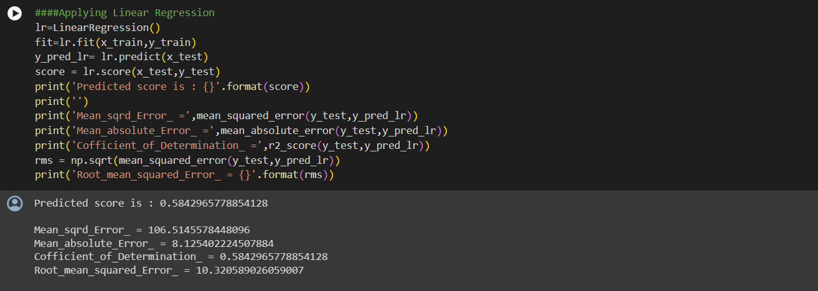
Linear Regression

Slide 24
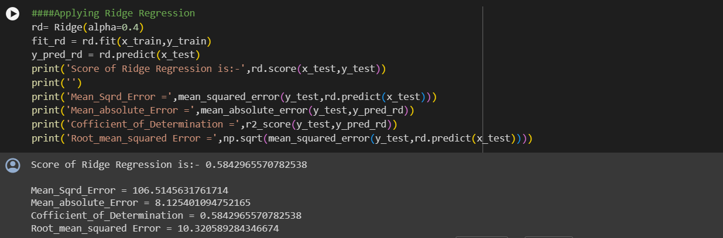
Rigid Regression

Slide 25
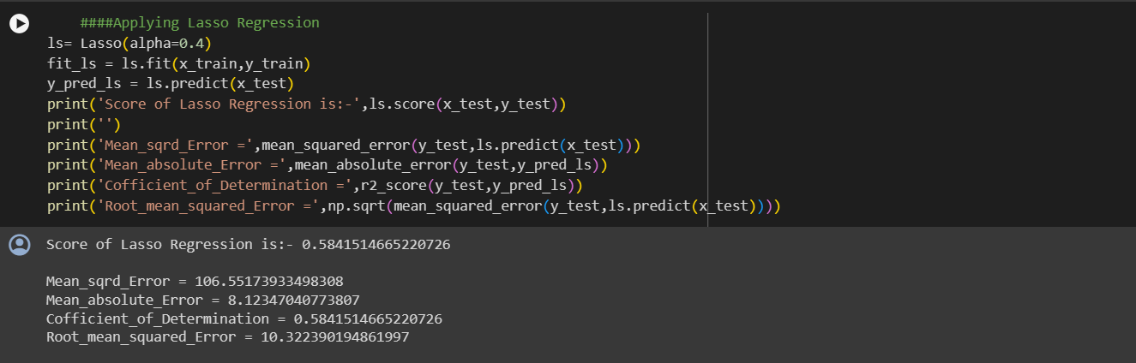
Lasso Regression

Slide 26
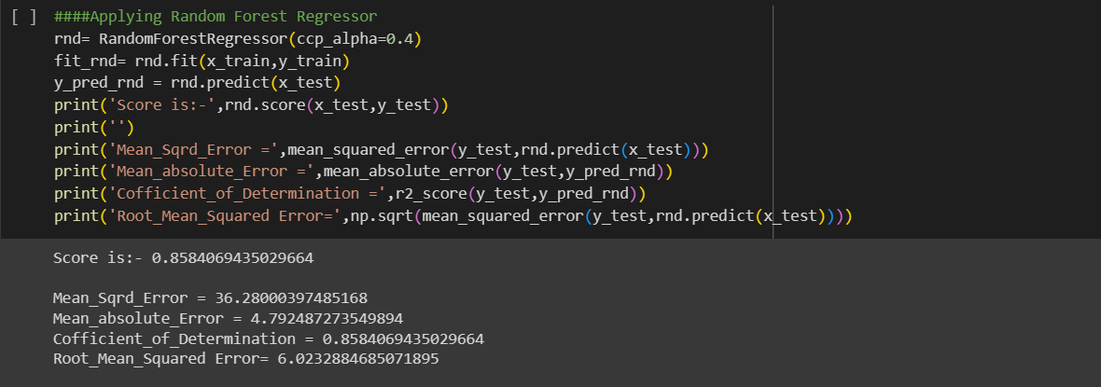
Random Forest Regression

Slide 27
Conclusion
For prediction were used 4 machine learning algorithms
Linear regression
Random forest regression
Ridge regreesion
Lasso regression
From the heat map we observe age and super plastisizer are 2 other feature which are strongly correlated with compressive strength and super plasticizer seems to have -ve highly correlation with water,positive correlation with fly and fine aggregate
Strenght decreses with increase in water,strength increase with increase in super platicizer
Comparing the root mean square error (RMSE),mean square error(MSE),mean absolute error(MAE) and R2 score linear regression,lasso regression,Ridge regression the performance seems to be similar with 3 methods
27

Slide 28

THANK YOU
from G2
28

